Slide 1
multiplication

Slide 2
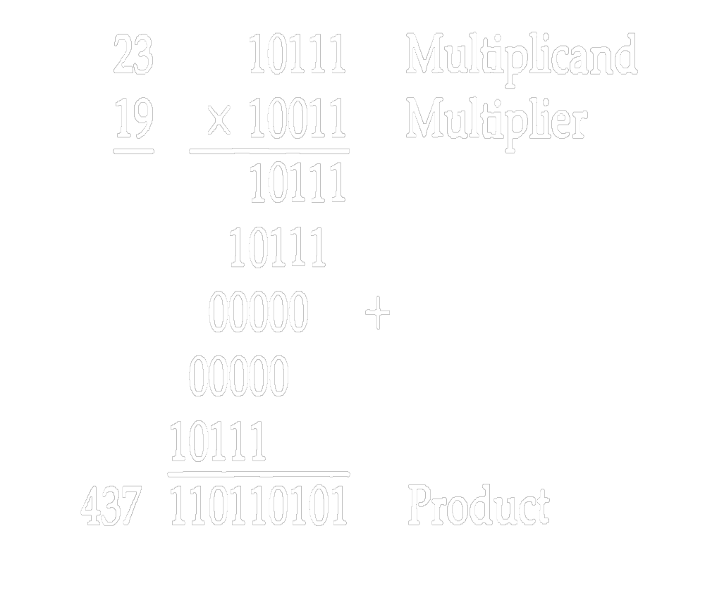
Multiplication Algorithm

Slide 3
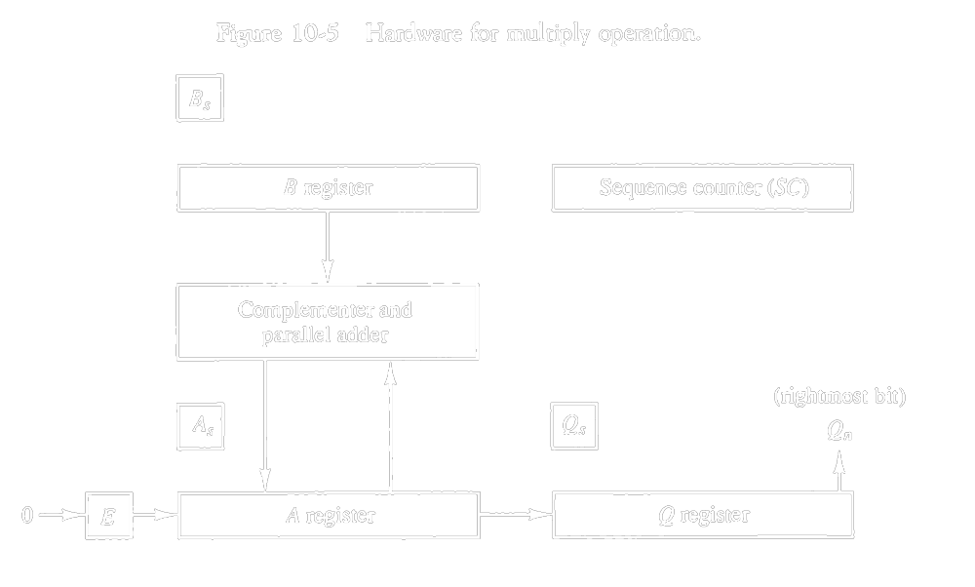
Hardware Implementation for Signed-Magnitude Data

Slide 4
Hardware Implementation of Signed Magnitude Data (cont..)
The registers together with registers A and B are shown in Fig. 10-5. The multiplier is stored in the Q register and its sign in Qs.
The sequence counter SC is initially set to a number equal to the number of bits in the multiplier. The counter is decremented by 1 after forming each partial product.
When the content of the counter reaches zero, the product is formed and the process stops.

Slide 5
Hardware Implementation for Signed- magnitude Data (Cont..)
Initially, the multiplicand is in register B and the multiplier in Q. The sum of A and B forms a partial product which is transferred to the EA register.
Both partial product and multiplier are shifted to the right. This shift will be denoted by the statement shr EAQ to designate the right shift depicted in Fig. 10-5.
The least significant bit of A is shifted into the most significant position of Q, the bit from £ is shifted into the most significant position of A, and 0 is shifted into £.
After the shift, one bit of the partial product is shifted into Q, pushing the multiplier bits one position to the right.
In this manner, the rightmost flip-flop in register Q, designated by Q„, will hold the bit of the multiplier, which must be inspected next.

Slide 6
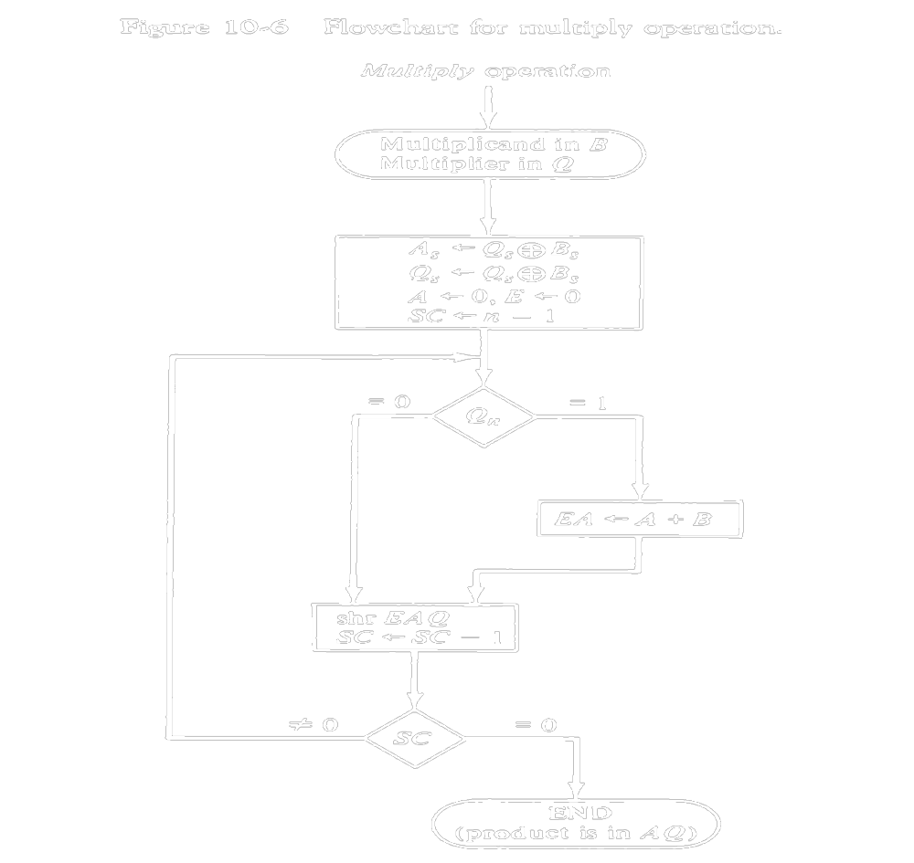
flowchart for multiply operation

Slide 7
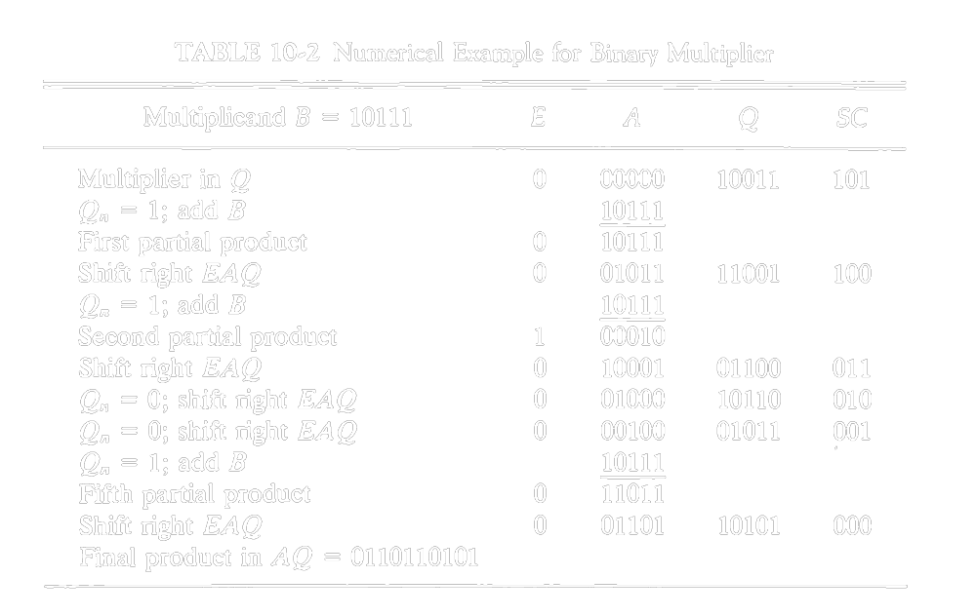
Numerical Example

Slide 8
Booth’s Multiplication Algorithm
Booth algorithm gives a procedure for multiplying binary integers in signed-2's complement representation.
It operates on the fact that strings of 0's in the multiplier require no addition but just shifting, and a string of l's in the multiplier from bit weight 2k to weight 2m can be treated as 2fc+1 - 2m.
For example, the binary number 001110 (+14) has a string of l's from 23 to 21 (k = 3, m = 1).
The number can be represented as 2fc+1 - 2m = 24 - 21 = 16 - 2 = 14. Therefore, the multiplication M x 14, where M is the multiplicand and 14 the multiplier, can be done as M x 24 - M x 21.
Thus the product can be obtained by shifting the binary multiplicand M four times to the left and subtracting M shifted left once.

Slide 9
Booth’s Algorithm
1. The multiplicand is subtracted from the partial product upon encountering the first least significant 1 in a string of l's in the multiplier.
2. The multiplicand is added to the partial product upon encountering the first 0 (provided that there was a previous 1) in a string of Cs in the
multiplier.
3. The partial product does not change when the multiplier bit is identical to the previous multiplier bit.
The algorithm works for positive or negative multipliers in 2's complement representation. This is because a negative multiplier ends with a string of l's and the last operation will be a subtraction of the appropriate weight. For example, a multiplier equal to -14 is represented in 2's complement as 110010 and is treated as -24 + 22 - 21 = -14.

Slide 10
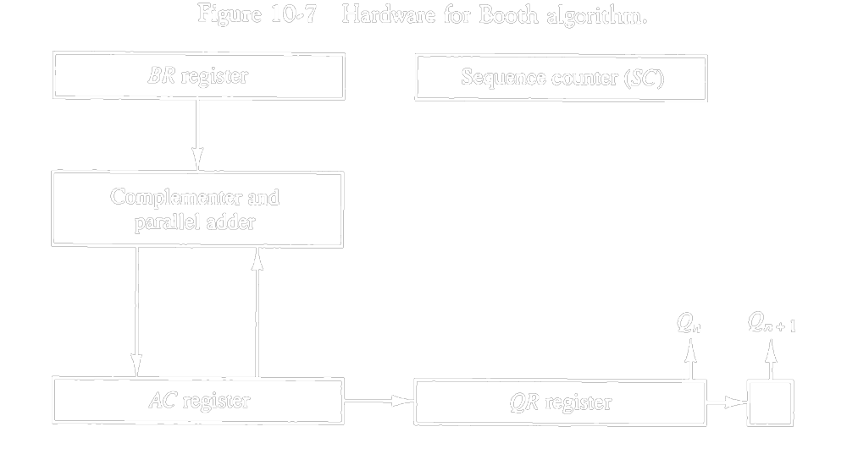
Hardware Implementation

Slide 11
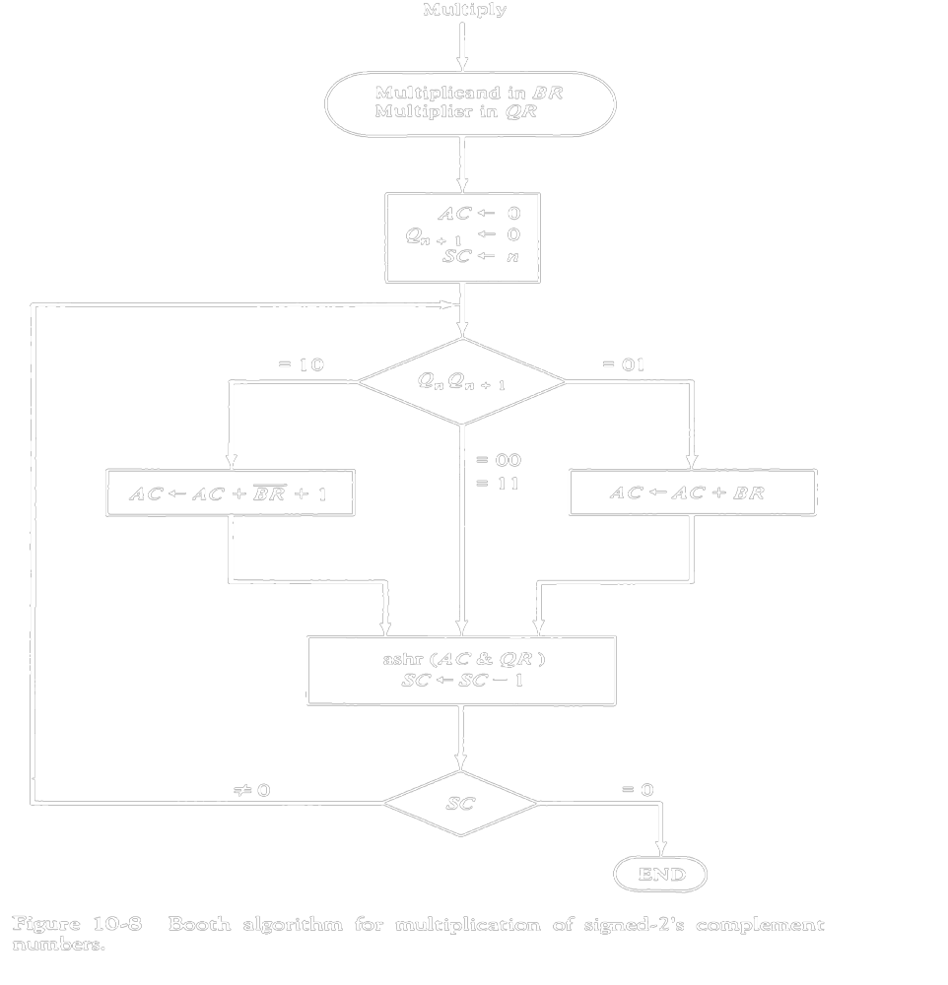
Hardware Algorithm

Slide 12
References
Morris Mano, “ Computer System Architecture”, Pearson Education, 3rd edition.

